Slide 1
RUSTikales Rust for beginners
©Philippe Felix Haupt 2023

Slide 2
Plan for today
©Philippe Felix Haupt 2023

Slide 3
Plan for today
Recap
©Philippe Felix Haupt 2023

Slide 4
Plan for today
Recap
What makes Rust Rust
©Philippe Felix Haupt 2023

Slide 5
Plan for today
Recap
What makes Rust Rust
Ownership
©Philippe Felix Haupt 2023

Slide 6
Plan for today
Recap
What makes Rust Rust
Ownership
References
©Philippe Felix Haupt 2023

Slide 7
Plan for today
Recap
What makes Rust Rust
Ownership
References
Borrow Checker
©Philippe Felix Haupt 2023

Slide 8
Recap
Primitive Types in Rust: i8, u8, …, i128, u128, bool
©Philippe Felix Haupt 2023

Slide 9
Recap
Primitive Types in Rust: i8, u8, …, i128, u128, bool
`let` to declare an immutable variable, `let mut` for mutable variables
©Philippe Felix Haupt 2023

Slide 10
Recap
Primitive Types in Rust: i8, u8, …, i128, u128, bool
`let` to declare an immutable variable, `let mut` for mutable variables
`let var: [type; size] = …;` to declare an array with the given type and size
`let var: Vec<type> = …;` to declare a Vector with the given type
©Philippe Felix Haupt 2023

Slide 11
Recap
Primitive Types in Rust: i8, u8, …, i128, u128, bool
`let` to declare an immutable variable, `let mut` for mutable variables
`let var: [type; size] = …;` to declare an array with the given type and size
`let var: Vec<type> = …;` to declare a Vector with the given type
`var[index]` to access an element at a given index
©Philippe Felix Haupt 2023

Slide 12
Recap
Primitive Types in Rust: i8, u8, …, i128, u128, bool
`let` to declare an immutable variable, `let mut` for mutable variables
`let var: [type; size] = …;` to declare an array with the given type and size
`let var: Vec<type> = …;` to declare a Vector with the given type
`var[index]` to access an element at a given index
Arrays and Vectors are zero-indexed
For size `N`, indices 0 to N-1 are defined, Rest results in Out Of Bounds Errors
©Philippe Felix Haupt 2023

Slide 13
Recap
Primitive Types in Rust: i8, u8, …, i128, u128, bool
`let` to declare an immutable variable, `let mut` for mutable variables
`let var: [type; size] = …;` to declare an array with the given type and size
`let var: Vec<type> = …;` to declare a Vector with the given type
`var[index]` to access an element at a given index
Arrays and Vectors are zero-indexed
For size `N`, indices 0 to N-1 are defined, Rest results in Out Of Bounds Errors
loop { } to create an infinite loop
©Philippe Felix Haupt 2023

Slide 14
Recap
Primitive Types in Rust: i8, u8, …, i128, u128, bool
`let` to declare an immutable variable, `let mut` for mutable variables
`let var: [type; size] = …;` to declare an array with the given type and size
`let var: Vec<type> = …;` to declare a Vector with the given type
`var[index]` to access an element at a given index
Arrays and Vectors are zero-indexed
For size `N`, indices 0 to N-1 are defined, Rest results in Out Of Bounds Errors
loop { } to create an infinite loop
while condition { } to create a conditional loop
©Philippe Felix Haupt 2023

Slide 15
Recap
Primitive Types in Rust: i8, u8, …, i128, u128, bool
`let` to declare an immutable variable, `let mut` for mutable variables
`let var: [type; size] = …;` to declare an array with the given type and size
`let var: Vec<type> = …;` to declare a Vector with the given type
`var[index]` to access an element at a given index
Arrays and Vectors are zero-indexed
For size `N`, indices 0 to N-1 are defined, Rest results in Out Of Bounds Errors
loop { } to create an infinite loop
while condition { } to create a conditional loop
for elem in collection { } to create an iterator over a collection
©Philippe Felix Haupt 2023

Slide 16
Recap
Primitive Types in Rust: i8, u8, …, i128, u128, bool
`let` to declare an immutable variable, `let mut` for mutable variables
`let var: [type; size] = …;` to declare an array with the given type and size
`let var: Vec<type> = …;` to declare a Vector with the given type
`var[index]` to access an element at a given index
Arrays and Vectors are zero-indexed
For size `N`, indices 0 to N-1 are defined, Rest results in Out Of Bounds Errors
loop { } to create an infinite loop
while condition { } to create a conditional loop
for elem in collection { } to create an iterator over a collection
loop, while and for are equally powerful, but in certain situations some loops are better
Infinite loop using `for` is weird
Iterating over a collection using `loop` is convoluted and needs a lot of work
©Philippe Felix Haupt 2023

Slide 17
Recap
Exercises:
Did you look at them?
Did you understand them?
Were you able to solve them?
©Philippe Felix Haupt 2023

Slide 18
Recap
Exercises:
Did you look at them?
Did you understand them?
Were you able to solve them?
Important to know:
©Philippe Felix Haupt 2023

Slide 19
Recap
Exercises:
Did you look at them?
Did you understand them?
Were you able to solve them?
Important to know:
in a for n in x..y { } loop, `n` will not take on the value of `y`
for that, use for n in x..=y { } (note the `=`)
`..` is non-inclusive
©Philippe Felix Haupt 2023

Slide 20
Recap
Exercises:
Did you look at them?
Did you understand them?
Were you able to solve them?
Important to know:
in a for n in x..y { } loop, `n` will not take on the value of `y`
use `break` to exit out of a loop early
©Philippe Felix Haupt 2023

Slide 21
Recap
Exercises:
Did you look at them?
Did you understand them?
Were you able to solve them?
Important to know:
in a for n in x..y { } loop, `n` will not take on the value of `y`
use `break` to exit out of a loop early
use `continue` to skip one loop pass
©Philippe Felix Haupt 2023

Slide 22
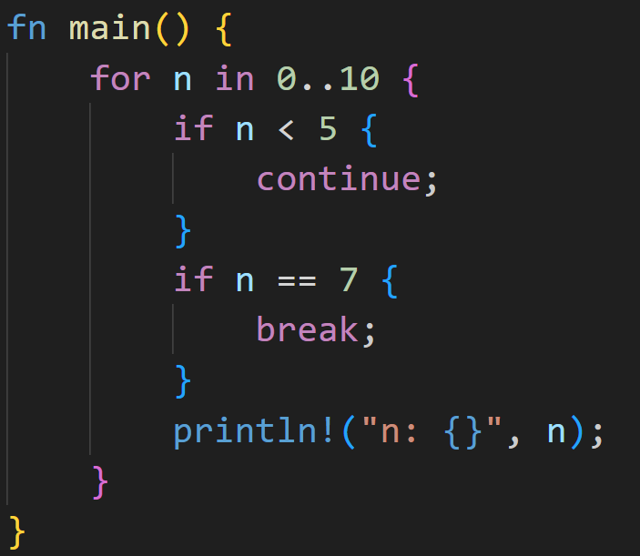
Recap
©Philippe Felix Haupt 2023

Slide 23
Recap
Program will jump to the top pink bracket if n is less than 5
©Philippe Felix Haupt 2023

Slide 24
Recap
Program will jump to the top pink bracket if n is less than 5
Program will jump to the bottom pink bracket if n is equal to 7
©Philippe Felix Haupt 2023

Slide 25
Recap
1/3
What does this print?
©Philippe Felix Haupt 2023

Slide 26
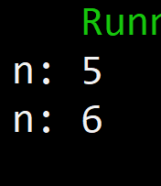
Recap
1/3
What does this print?
©Philippe Felix Haupt 2023

Slide 27
Recap
Exercises:
Did you look at them?
Did you understand them?
Were you able to solve them?
Important to know:
in a for n in x..y { } loop, `n` will not take on the value of `y`
use `break` to exit out of a loop early
use `continue` to skip one loop pass
©Philippe Felix Haupt 2023

Slide 28
Recap
Exercises:
Did you look at them?
Did you understand them?
Were you able to solve them?
Important to know:
in a for n in x..y { } loop, `n` will not take on the value of `y`
use `break` to exit out of a loop early
use `continue` to skip one loop pass
You can nest loops
Nesting means putting a structure inside itself
Similar to nested arrays
©Philippe Felix Haupt 2023

Slide 29
Recap
Exercises:
Did you look at them?
Did you understand them?
Were you able to solve them?
Important to know:
in a for n in x..y { } loop, `n` will not take on the value of `y`
use `break` to exit out of a loop early
use `continue` to skip one loop pass
You can nest loops
Loops allow us to control the flow of the program
We can now implement simple algorithms, such as:
The factorial of a number - `n!`
Primality test - is `n` a prime?
©Philippe Felix Haupt 2023

Slide 30
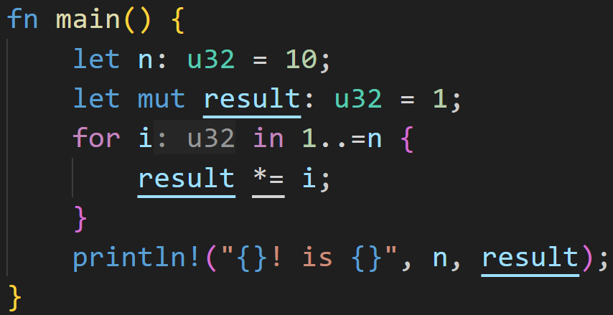
Recap
©Philippe Felix Haupt 2023

Slide 31
Recap
Factorial `n!` is defined as the product of all natural numbers (except 0) less than or equal n.
©Philippe Felix Haupt 2023

Slide 32
Recap
Factorial `n!` is defined as the product of all natural numbers (except 0) less than or equal n.
product
©Philippe Felix Haupt 2023

Slide 33
Recap
Factorial `n!` is defined as the product of all natural numbers (except 0) less than or equal n.
of all natural numbers less than or equal to n
product
©Philippe Felix Haupt 2023

Slide 34

Recap
©Philippe Felix Haupt 2023

Slide 35
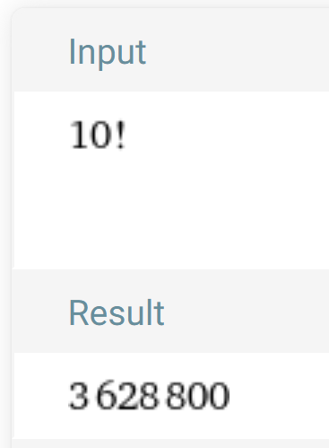
Recap
WolframAlpha:
©Philippe Felix Haupt 2023

Slide 36
What makes Rust Rust
©Philippe Felix Haupt 2023

Slide 37
What makes Rust Rust
Last time: Using a `Vector` in a for-loop made the variable invalid after the loop
©Philippe Felix Haupt 2023

Slide 38
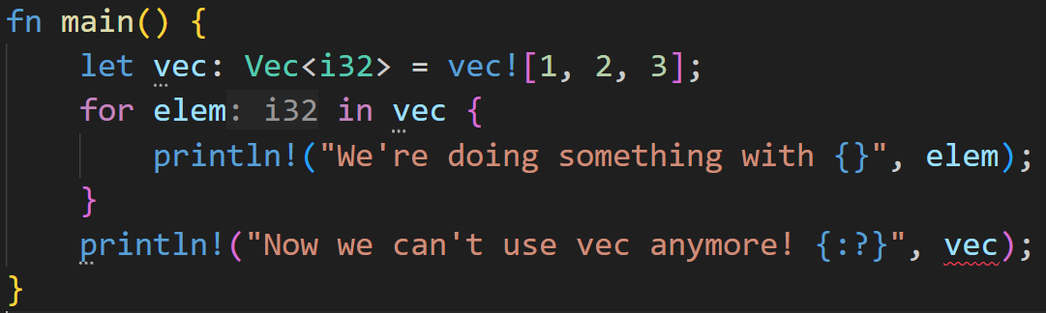
What makes Rust Rust
Last time: Using a `Vector` in a for-loop made the variable invalid after the loop
©Philippe Felix Haupt 2023

Slide 39
What makes Rust Rust
Last time: Using a `Vector` in a for-loop made the variable invalid after the loop
red wiggly lines are never good!
©Philippe Felix Haupt 2023

Slide 40
What makes Rust Rust
Last time: Using a `Vector` in a for-loop made the variable invalid after the loop
Dots mean that the mistake lies here
red wiggly lines are never good!
©Philippe Felix Haupt 2023

Slide 41
What makes Rust Rust
Last time: Using a `Vector` in a for-loop made the variable invalid after the loop
Let’s take a closer look at the error:
©Philippe Felix Haupt 2023

Slide 42
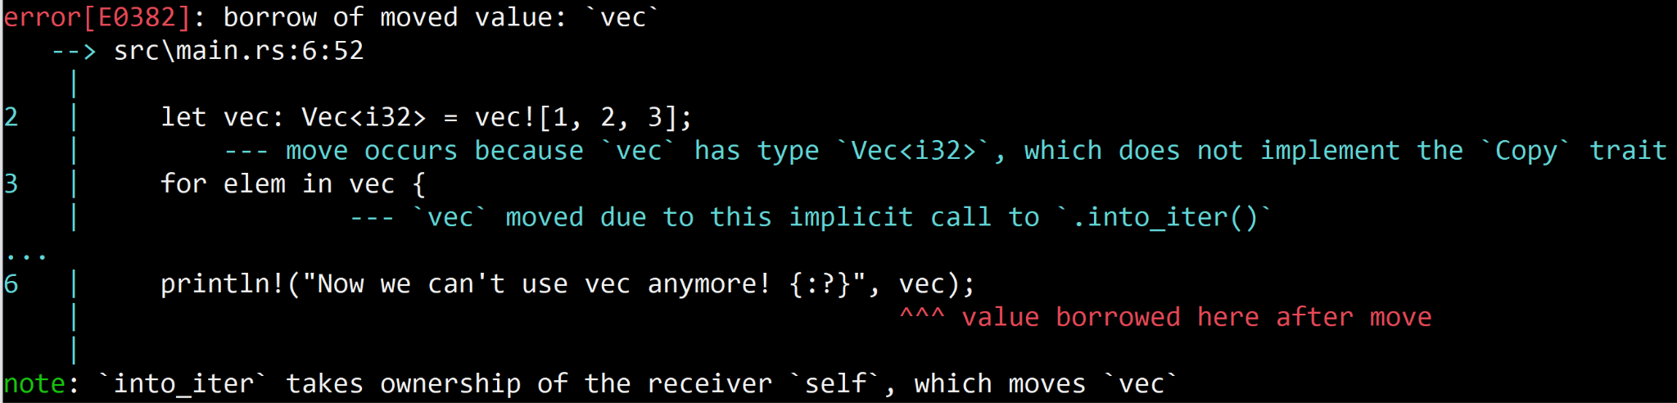
What makes Rust Rust
Last time: Using a `Vector` in a for-loop made the variable invalid after the loop
Let’s take a closer look at the error:
©Philippe Felix Haupt 2023

Slide 43
What makes Rust Rust
Last time: Using a `Vector` in a for-loop made the variable invalid after the loop
Let’s take a closer look at the error:
A lot of words, let’s focus on the important bits
©Philippe Felix Haupt 2023

Slide 44
What makes Rust Rust
Last time: Using a `Vector` in a for-loop made the variable invalid after the loop
Let’s take a closer look at the error:
A lot of words, let’s focus on the important bits
©Philippe Felix Haupt 2023

Slide 45
What makes Rust Rust
Last time: Using a `Vector` in a for-loop made the variable invalid after the loop
Let’s take a closer look at the error:
A lot of words, let’s focus on the important bits,
boiling it down even more
©Philippe Felix Haupt 2023

Slide 46
What makes Rust Rust
Last time: Using a `Vector` in a for-loop made the variable invalid after the loop
Let’s take a closer look at the error
Error boiled down to three keywords:
Borrowed
Moved
Ownership
©Philippe Felix Haupt 2023

Slide 47
What makes Rust Rust
Last time: Using a `Vector` in a for-loop made the variable invalid after the loop
Let’s take a closer look at the error
Error boiled down to three keywords:
Borrowed
Moved
Ownership
Today, we’re diving deep down into the world of Rust
©Philippe Felix Haupt 2023

Slide 48
What makes Rust Rust - Ownership
©Philippe Felix Haupt 2023

Slide 49
What makes Rust Rust - Ownership
At some point, every compiler constructor has to address the elephant in the room: Memory Management
©Philippe Felix Haupt 2023

Slide 50
What makes Rust Rust - Ownership
At some point, every compiler constructor has to address the elephant in the room: Memory Management
How do you handle data structures, how do you handle heap allocations, etcetc
©Philippe Felix Haupt 2023

Slide 51
What makes Rust Rust - Ownership
The elephant in the room: Memory Management
How do you handle data structures, how do you handle heap allocations, etcetc
Many different techniques exist:
©Philippe Felix Haupt 2023

Slide 52
What makes Rust Rust - Ownership
The elephant in the room: Memory Management
How do you handle data structures, how do you handle heap allocations, etcetc
Many different techniques exist:
Manual Management, like in C or Assembly
©Philippe Felix Haupt 2023

Slide 53
What makes Rust Rust - Ownership
The elephant in the room: Memory Management
How do you handle data structures, how do you handle heap allocations, etcetc
Many different techniques exist:
Manual Management, like in C or Assembly
Garbage Collector, like in Java or Python
©Philippe Felix Haupt 2023

Slide 54
What makes Rust Rust - Ownership
The elephant in the room: Memory Management
How do you handle data structures, how do you handle heap allocations, etcetc
Many different techniques exist:
Manual Management, like in C or Assembly
Garbage Collector, like in Java or Python
Automatic Reference Counting, like in Swift
©Philippe Felix Haupt 2023

Slide 55
What makes Rust Rust - Ownership
The elephant in the room: Memory Management
How do you handle data structures, how do you handle heap allocations, etcetc
Many different techniques exist:
Manual Management, like in C or Assembly
Garbage Collector, like in Java or Python
Automatic Reference Counting, like in Swift
Ownership-Model, like in Rust or… Well, so far only Rust has really pulled it off
©Philippe Felix Haupt 2023

Slide 56
What makes Rust Rust - Ownership
The elephant in the room: Memory Management
How do you handle data structures, how do you handle heap allocations, etcetc
Many different techniques exist
The Ownership-Model is the technique used in Rust, it controls everything
©Philippe Felix Haupt 2023

Slide 57
What makes Rust Rust - Ownership
The elephant in the room: Memory Management
How do you handle data structures, how do you handle heap allocations, etcetc
Many different techniques exist
The Ownership-Model is the technique used in Rust, it controls everything
Set of rules that must be true at any point in the program:
©Philippe Felix Haupt 2023

Slide 58
What makes Rust Rust - Ownership
The elephant in the room: Memory Management
How do you handle data structures, how do you handle heap allocations, etcetc
Many different techniques exist
The Ownership-Model is the technique used in Rust, it controls everything
Set of rules that must be true at any point in the program:
Each value in Rust has an owner
Your integer `5` on the Stack has an owner
Your Vector `vec` on the Heap has an owner
©Philippe Felix Haupt 2023

Slide 59
What makes Rust Rust - Ownership
The elephant in the room: Memory Management
How do you handle data structures, how do you handle heap allocations, etcetc
Many different techniques exist
The Ownership-Model is the technique used in Rust, it controls everything
Set of rules that must be true at any point in the program:
Each value in Rust has an owner
There can only be one owner at any given time
This is related to the Vector-problem we faced earlier
©Philippe Felix Haupt 2023

Slide 60
What makes Rust Rust - Ownership
The elephant in the room: Memory Management
How do you handle data structures, how do you handle heap allocations, etcetc
Many different techniques exist
The Ownership-Model is the technique used in Rust, it controls everything
Set of rules that must be true at any point in the program:
Each value in Rust has an owner
There can only be one owner at any given time
When the owner goes out of scope, the value will be dropped (memory will be freed)
Out of scope, unless specified otherwise, means the end of the code block the value was declared in
©Philippe Felix Haupt 2023

Slide 61
What makes Rust Rust - Ownership
The elephant in the room: Memory Management
How do you handle data structures, how do you handle heap allocations, etcetc
Many different techniques exist
The Ownership-Model is the technique used in Rust, it controls everything
Set of rules that must be true at any point in the program:
Each value in Rust has an owner
There can only be one owner at any given time
When the owner goes out of scope, the value will be dropped (memory will be freed)
If your code breaks any of those rules at any point, it’s not a valid Rust program and will be rejected by the compiler
©Philippe Felix Haupt 2023

Slide 62
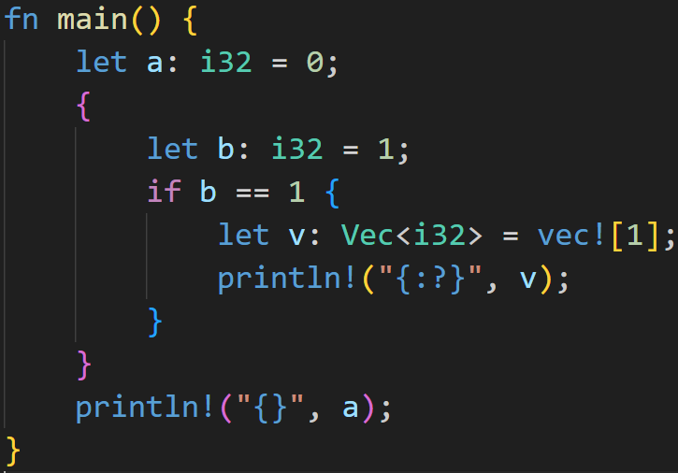
What makes Rust Rust - Ownership
©Philippe Felix Haupt 2023

Slide 63
What makes Rust Rust - Ownership
Vector will be dropped here
©Philippe Felix Haupt 2023

Slide 64
What makes Rust Rust - Ownership
Vector will be dropped here
Value `1` will be dropped here
©Philippe Felix Haupt 2023

Slide 65
What makes Rust Rust - Ownership
Vector will be dropped here
Value `1` will be dropped here
Value `0` will be dropped here
©Philippe Felix Haupt 2023

Slide 66
What makes Rust Rust - Ownership
Variables can interact with the same data in different ways in Rust
©Philippe Felix Haupt 2023

Slide 67
What makes Rust Rust - Ownership
Variables can interact with the same data in different ways in Rust
Data can be copied
©Philippe Felix Haupt 2023

Slide 68
What makes Rust Rust - Ownership
Variables can interact with the same data in different ways in Rust
Data can be copied
Data can be moved
©Philippe Felix Haupt 2023

Slide 69
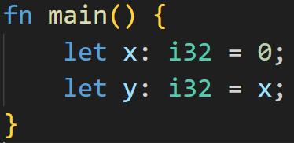
What makes Rust Rust - Ownership
Variables can interact with the same data in different ways in Rust
Data can be copied
Data can be moved
Let’s consider another example
©Philippe Felix Haupt 2023

Slide 70
What makes Rust Rust - Ownership
Variables can interact with the same data in different ways in Rust
Data can be copied
Data can be moved
Let’s consider another example
The size of i32 is known, it is located on the stack, so Rust copies the value of x
©Philippe Felix Haupt 2023

Slide 71
What makes Rust Rust - Ownership
Variables can interact with the same data in different ways in Rust
Data can be copied
Data can be moved
Let’s consider another example
The size of i32 is known, it is located on the stack, so Rust copies the value of x
Assign a copy of x to y
©Philippe Felix Haupt 2023

Slide 72
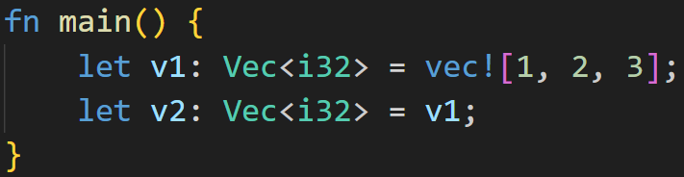
What makes Rust Rust - Ownership
©Philippe Felix Haupt 2023

Slide 73
What makes Rust Rust - Ownership
Vector is more complex: The data itself is located on the Heap, there’s only Metadata on the Stack: - Pointer to the Heap - Size of Vector - Capacity of Vector
©Philippe Felix Haupt 2023

Slide 74
What makes Rust Rust - Ownership
Metadata on Stack
name | value
ptr
len | 3
capacity | 4
©Philippe Felix Haupt 2023

Slide 75
What makes Rust Rust - Ownership
Metadata on Stack
Somewhere on the Heap
name | value
ptr
len | 3
capacity | 4
index | value
0 | 1
1 | 2
2 | 3
©Philippe Felix Haupt 2023

Slide 76
What makes Rust Rust - Ownership
Metadata on Stack
Here, Rust still copies data on the Stack!
Somewhere on the Heap
name | value
ptr
len | 3
capacity | 4
index | value
0 | 1
1 | 2
2 | 3
©Philippe Felix Haupt 2023

Slide 77
What makes Rust Rust - Ownership
Metadata on Stack for v1
Somewhere on the Heap
name | value
ptr
len | 3
capacity | 4
index | value
0 | 1
1 | 2
2 | 3
Metadata on Stack for v2
name | value
ptr
len | 3
capacity | 4
©Philippe Felix Haupt 2023

Slide 78
What makes Rust Rust - Ownership
Metadata on Stack for v1
Somewhere on the Heap
name | value
ptr
len | 3
capacity | 4
index | value
0 | 1
1 | 2
2 | 3
Metadata on Stack for v2
name | value
ptr
len | 3
capacity | 4
This is very bad! v1 and v2 now point to the same heap location, and when dropped will both free the memory
©Philippe Felix Haupt 2023

Slide 79
What makes Rust Rust - Ownership
Metadata on Stack for v1
Somewhere on the Heap
name | value
ptr
len | 3
capacity | 4
index | value
0 | 1
1 | 2
2 | 3
Metadata on Stack for v2
name | value
ptr
len | 3
capacity | 4
This is very bad! v1 and v2 now point to the same heap location, and when dropped will both free the memory
Very bad for many reasons!
©Philippe Felix Haupt 2023

Slide 80
What makes Rust Rust - Ownership
Metadata on Stack for v1
Somewhere on the Heap
name | value
ptr
len | 3
capacity | 4
index | value
0 | 1
1 | 2
2 | 3
Metadata on Stack for v2
What does Rust do? It invalidates v1, and moves the data into v2
name | value
ptr
len | 3
capacity | 4
©Philippe Felix Haupt 2023

Slide 81
What makes Rust Rust - Ownership
Metadata on Stack for v1
Somewhere on the Heap
name | value
ptr
len | 3
capacity | 4
index | value
0 | 1
1 | 2
2 | 3
Metadata on Stack for v2
What does Rust do? It invalidates v1, and moves the data into v2
name | value
ptr
len | 3
capacity | 4
©Philippe Felix Haupt 2023

Slide 82
What makes Rust Rust - Ownership
Metadata on Stack for v1
Somewhere on the Heap
name | value
ptr
len | 3
capacity | 4
index | value
0 | 1
1 | 2
2 | 3
Metadata on Stack for v2
What does Rust do? It invalidates v1, and moves the data into v2 By doing that, the data on the heap will only be freed once, everything is fine!
name | value
ptr
len | 3
capacity | 4
©Philippe Felix Haupt 2023

Slide 83
What makes Rust Rust - Ownership
after the 2nd line, `v1` was moved into `v2`
and can’t be used anymore!
©Philippe Felix Haupt 2023

Slide 84
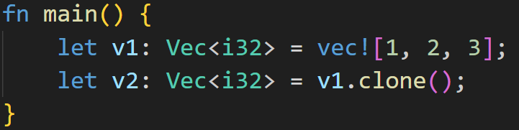
What makes Rust Rust - Ownership
after the 2nd line, `v1` was moved into `v2`
and can’t be used anymore!
If you still want to use v1, you need to copy the vector yourself using `.clone()`
©Philippe Felix Haupt 2023

Slide 85
What makes Rust Rust - Ownership
Let’s go back to the Vector-example:
©Philippe Felix Haupt 2023

Slide 86
What makes Rust Rust - Ownership
With our newfound knowledge, this error makes sense!
Let’s go back to the Vector-example:
©Philippe Felix Haupt 2023

Slide 87
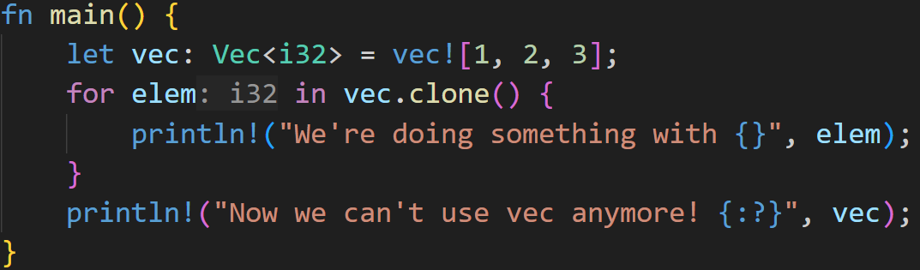
What makes Rust Rust - Ownership
Easy fix, clone it!!
Let’s go back to the Vector-example:
©Philippe Felix Haupt 2023

Slide 88

What makes Rust Rust - Ownership
Easy fix, clone it!?
Let’s go back to the Vector-example:
©Philippe Felix Haupt 2023

Slide 89
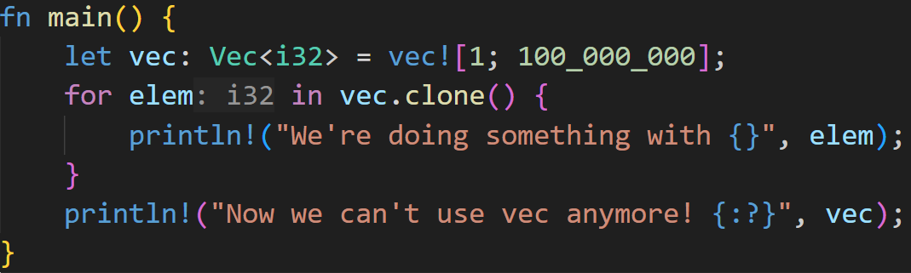
What makes Rust Rust - Ownership
Let’s go back to the Vector-example:
©Philippe Felix Haupt 2023

Slide 90
What makes Rust Rust - Ownership
Let’s go back to the Vector-example:
Cloning might take a while…
©Philippe Felix Haupt 2023

Slide 91
What makes Rust Rust - Ownership
Let’s go back to the Vector-example:
Cloning might take a while…
Back to our original problem anyway!! We want to modify `vec`, not any copies of it!
©Philippe Felix Haupt 2023

Slide 92
What makes Rust Rust - References
References offer an additional way of accessing data of a variable
©Philippe Felix Haupt 2023

Slide 93
What makes Rust Rust - References
References offer an additional way of accessing data of a variable
References do not involve copying or moving, and do not invalidate original variables
©Philippe Felix Haupt 2023

Slide 94
What makes Rust Rust - References
References offer an additional way of accessing data of a variable
References do not involve copying or moving, and do not invalidate original variables
A reference in programming is similar to a real life reference:
©Philippe Felix Haupt 2023

Slide 95
What makes Rust Rust - References
References offer an additional way of accessing data of a variable
References do not involve copying or moving, and do not invalidate original variables
A reference in programming is similar to a real life reference:
When you’re referring to something, you do not own it, but simply point to it
©Philippe Felix Haupt 2023

Slide 96
What makes Rust Rust - References
References offer an additional way of accessing data of a variable
References do not involve copying or moving, and do not invalidate original variables
A reference in programming is similar to a real life reference:
When you’re referring to something, you do not own it, but simply point to it
A reference in a book might link to another book written by another author
©Philippe Felix Haupt 2023

Slide 97
What makes Rust Rust - References
References offer an additional way of accessing data of a variable
References do not involve copying or moving, and do not invalidate original variables
A reference in programming is similar to a real life reference:
When you’re referring to something, you do not own it, but simply point to it
A reference in a book might link to another book written by another author
That other book might change in the meantime, but the reference still points to it
©Philippe Felix Haupt 2023

Slide 98
What makes Rust Rust - References
References offer an additional way of accessing data of a variable
References do not involve copying or moving, and do not invalidate original variables
A reference in programming is similar to a real life reference:
When you’re referring to something, you do not own it, but simply point to it
A reference in a book might link to another book written by another author
That other book might change in the meantime, but the reference still points to it
References in Rust do the same, they simply point to another variable
©Philippe Felix Haupt 2023

Slide 99
What makes Rust Rust - References
References offer an additional way of accessing data of a variable
References do not involve copying or moving, and do not invalidate original variables
A reference in programming is similar to a real life reference:
When you’re referring to something, you do not own it, but simply point to it
A reference in a book might link to another book written by another author
That other book might change in the meantime, but the reference still points to it
References in Rust do the same, they simply point to another variable
In the context of ownership, a reference is called `borrowing`:
“As in real life, if a person owns something, you can borrow it from them. When you’re done, you have to give it back. You don’t own it.” - Rustdocs
©Philippe Felix Haupt 2023

Slide 100
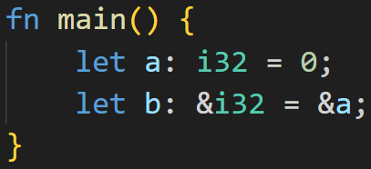
What makes Rust Rust - References
References offer an additional way of accessing data of a variable
References do not involve copying or moving, and do not invalidate original variables
A reference in programming is similar to a real life reference:
When you’re referring to something, you do not own it, but simply point to it
A reference in a book might link to another book written by another author
That other book might change in the meantime, but the reference still points to it
References in Rust do the same, they simply point to another variable
©Philippe Felix Haupt 2023

Slide 101
What makes Rust Rust - References
References offer an additional way of accessing data of a variable
References do not involve copying or moving, and do not invalidate original variables
A reference in programming is similar to a real life reference:
When you’re referring to something, you do not own it, but simply point to it
A reference in a book might link to another book written by another author
That other book might change in the meantime, but the reference still points to it
References in Rust do the same, they simply point to another variable
reference to `a`
©Philippe Felix Haupt 2023

Slide 102
What makes Rust Rust - References
References offer an additional way of accessing data of a variable
References do not involve copying or moving, and do not invalidate original variables
A reference in programming is similar to a real life reference:
When you’re referring to something, you do not own it, but simply point to it
A reference in a book might link to another book written by another author
That other book might change in the meantime, but the reference still points to it
References in Rust do the same, they simply point to another variable
Type: Reference to i32
reference to `a`
©Philippe Felix Haupt 2023

Slide 103
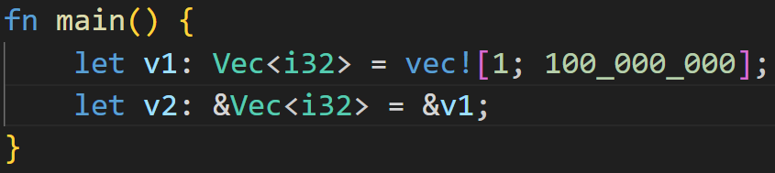
What makes Rust Rust - References
©Philippe Felix Haupt 2023

Slide 104
What makes Rust Rust - References
reference to v1, no Copy or Move involved!! v1 is still valid after this line!
©Philippe Felix Haupt 2023

Slide 105
What makes Rust Rust - References
Metadata on Stack for v1
Somewhere on the Heap
name | value
ptr
len | 100_000_000
capacity | 100_000_000
index | value
0 | 1
1 | 1
… | 1
©Philippe Felix Haupt 2023

Slide 106
What makes Rust Rust - References
Metadata on Stack for v2
Metadata on Stack for v1
Somewhere on the Heap
name | value
ptr
name | value
ptr
len | 100_000_000
capacity | 100_000_000
index | value
0 | 1
1 | 1
… | 1
©Philippe Felix Haupt 2023

Slide 107
What makes Rust Rust - References
But now both variables are immutable, can we also take a mutable reference?
©Philippe Felix Haupt 2023

Slide 108
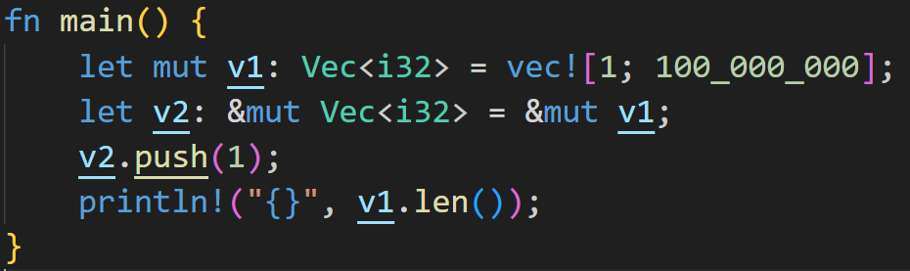
What makes Rust Rust - References
Of course! Mutable references look like this!
©Philippe Felix Haupt 2023

Slide 109
What makes Rust Rust - References
We’ve pushed an element to v2, but the length of v1 has also increased! The power of references :^)
©Philippe Felix Haupt 2023

Slide 110
What makes Rust Rust - References
BUT! There’s a catch!
We’ve pushed an element to v2, but the length of v1 has also increased! The power of references :^)
©Philippe Felix Haupt 2023

Slide 111
What makes Rust Rust - Borrow Checker
©Philippe Felix Haupt 2023

Slide 112
What makes Rust Rust - Borrow Checker
References are powerful, but also can lead to all sorts of bugs if not treated carefully
©Philippe Felix Haupt 2023

Slide 113
What makes Rust Rust - Borrow Checker
References are powerful, but also can lead to all sorts of bugs if not treated carefully
Ask your local Java developer, he’ll tell you a story or two
Here a Java example:
©Philippe Felix Haupt 2023

Slide 114
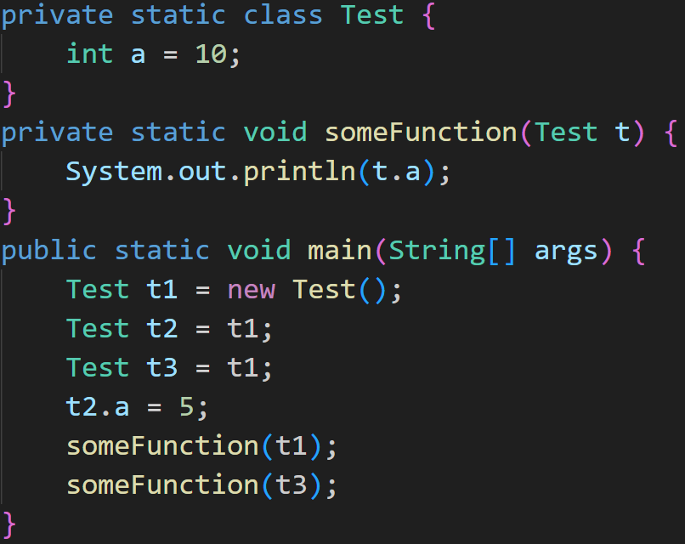
What makes Rust Rust - Borrow Checker
References are powerful, but also can lead to all sorts of bugs if not treated carefully
Ask your local Java developer, he’ll tell you a story or two
Here a Java example:
©Philippe Felix Haupt 2023

Slide 115
What makes Rust Rust - Borrow Checker
References are powerful, but also can lead to all sorts of bugs if not treated carefully
Ask your local Java developer, he’ll tell you a story or two
Here a Java example:
Class assignments in Java are references by default
©Philippe Felix Haupt 2023

Slide 116
What makes Rust Rust - Borrow Checker
References are powerful, but also can lead to all sorts of bugs if not treated carefully
Ask your local Java developer, he’ll tell you a story or two
Here a Java example:
By changing `t2`, you also modify `t1` and `t3`
©Philippe Felix Haupt 2023

Slide 117
What makes Rust Rust - Borrow Checker
References are powerful, but also can lead to all sorts of bugs if not treated carefully
Ask your local Java developer, he’ll tell you a story or two
Here a Java example:
Prints 5 for both `t1.a` and `t3.a`! Depending on the situation, you may not have wanted that!
Do something with `t1`
Do something with `t3`
©Philippe Felix Haupt 2023

Slide 118
What makes Rust Rust - Borrow Checker
References are powerful, but also can lead to all sorts of bugs if not treated carefully
Ask your local Java developer, he’ll tell you a story or two
Ask your local Multithreading-Developer, he’ll tell you a story or two
©Philippe Felix Haupt 2023

Slide 119
What makes Rust Rust - Borrow Checker
References are powerful, but also can lead to all sorts of bugs if not treated carefully
Ask your local Java developer, he’ll tell you a story or two
Ask your local Multithreading-Developer, he’ll tell you a story or two
Race condition:
Multiple pointers access the same data at the same time
One pointer writes data
At the same time, other pointer reads data:
Does it see the new value, or the old value?
©Philippe Felix Haupt 2023

Slide 120
What makes Rust Rust - Borrow Checker
References are powerful, but also can lead to all sorts of bugs if not treated carefully
Race condition
To prevent this, Rust has the Borrow Checker
©Philippe Felix Haupt 2023

Slide 121
What makes Rust Rust - Borrow Checker
References are powerful, but also can lead to all sorts of bugs if not treated carefully
Race condition
To prevent this, Rust has the Borrow Checker
Guarantees, at compile time, that no data races or race conditions happen
©Philippe Felix Haupt 2023

Slide 122
What makes Rust Rust - Borrow Checker
References are powerful, but also can lead to all sorts of bugs if not treated carefully
Race condition
To prevent this, Rust has the Borrow Checker
Guarantees, at compile time, that no data races or race conditions happen
Ruleset to enforce this is pretty simple, but takes a while to get used to:
©Philippe Felix Haupt 2023

Slide 123
What makes Rust Rust - Borrow Checker
References are powerful, but also can lead to all sorts of bugs if not treated carefully
Race condition
To prevent this, Rust has the Borrow Checker
Guarantees, at compile time, that no data races or race conditions happen
Ruleset to enforce this is pretty simple, but takes a while to get used to:
You can’t have more than 1 mutable reference to a variable at any given time
Similar race condition if you have 2 mutable references: Both write at the same time, what happens?
©Philippe Felix Haupt 2023

Slide 124
What makes Rust Rust - Borrow Checker
References are powerful, but also can lead to all sorts of bugs if not treated carefully
Race condition
To prevent this, Rust has the Borrow Checker
Guarantees, at compile time, that no data races or race conditions happen
Ruleset to enforce this is pretty simple, but takes a while to get used to:
You can’t have more than 1 mutable reference to a variable at any given time
If you have 1 mutable reference, you can’t have any immutable references to the same variable
Race condition, as stated before: Read/Write
©Philippe Felix Haupt 2023

Slide 125
What makes Rust Rust - Borrow Checker
References are powerful, but also can lead to all sorts of bugs if not treated carefully
Race condition
To prevent this, Rust has the Borrow Checker
Guarantees, at compile time, that no data races or race conditions happen
Ruleset to enforce this is pretty simple, but takes a while to get used to:
You can’t have more than 1 mutable reference to a variable at any given time
If you have 1 mutable reference, you can’t have any immutable references to the same variable
If you have 0 mutable references, you can have any number of immutable references
No problem, because 100 Reads don’t change the value of the variable :^)
©Philippe Felix Haupt 2023

Slide 126
What makes Rust Rust - Borrow Checker
References are powerful, but also can lead to all sorts of bugs if not treated carefully
Race condition
To prevent this, Rust has the Borrow Checker
Guarantees, at compile time, that no data races or race conditions happen
Ruleset to enforce this is pretty simple, but takes a while to get used to:
You can’t have more than 1 mutable reference to a variable at any given time
If you have 1 mutable reference, you can’t have any immutable references to the same variable
If you have 0 mutable references, you can have any number of immutable references
References must always be valid (e.g. no dangling references)
©Philippe Felix Haupt 2023

Slide 127
What makes Rust Rust - Borrow Checker
References are powerful, but also can lead to all sorts of bugs if not treated carefully
Race condition
To prevent this, Rust has the Borrow Checker
Guarantees, at compile time, that no data races or race conditions happen
Ruleset to enforce this is pretty simple, but takes a while to get used to:
You can’t have more than 1 mutable reference to a variable at any given time
If you have 1 mutable reference, you can’t have any immutable references to the same variable
If you have 0 mutable references, you can have any number of immutable references
References must always be valid (e.g. no dangling references)
Rule of Thumb: If the compiler shouts at you, say “yes sir” and move your code around :^)
©Philippe Felix Haupt 2023

Slide 128
What makes Rust Rust - Borrow Checker
To unlock full understanding of References in Rust, we need to talk about Lifetimes
We’ll cover them next week
©Philippe Felix Haupt 2023

Slide 129
What makes Rust Rust - Borrow Checker
To unlock full understanding of References in Rust, we need to talk about Lifetimes
We’ll cover them next week
A small important detail here:
References only fall into this rule as long as they’re used:
©Philippe Felix Haupt 2023

Slide 130
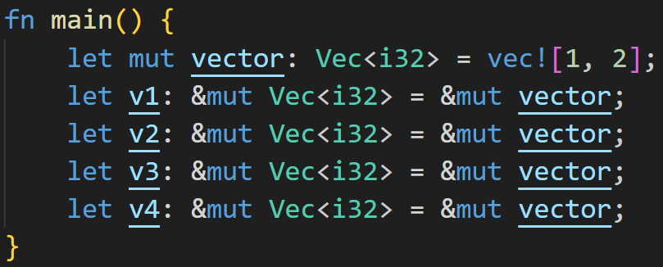
What makes Rust Rust - Borrow Checker
To unlock full understanding of References in Rust, we need to talk about Lifetimes
We’ll cover them next week
A small important detail here:
References only fall into this rule as long as they’re used:
©Philippe Felix Haupt 2023

Slide 131
What makes Rust Rust - Borrow Checker
To unlock full understanding of References in Rust, we need to talk about Lifetimes
We’ll cover them next week
A small important detail here:
References only fall into this rule as long as they’re used:
Even though we have 4 mutable references, it’s fine because we’re not doing anything with them!
©Philippe Felix Haupt 2023

Slide 132
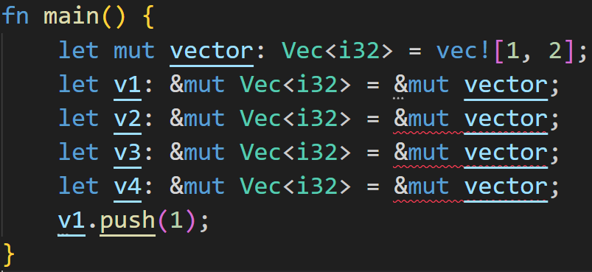
What makes Rust Rust - Borrow Checker
To unlock full understanding of References in Rust, we need to talk about Lifetimes
We’ll cover them next week
A small important detail here:
References only fall into this rule as long as they’re used:
We use mutable borrow of v1 in that range, so we can’t take any more mutable references in that range
©Philippe Felix Haupt 2023

Slide 133
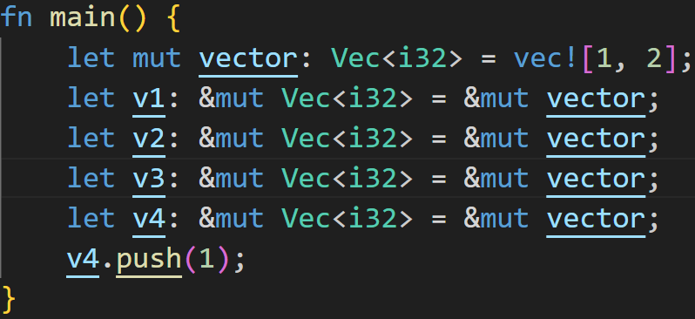
What makes Rust Rust - Borrow Checker
To unlock full understanding of References in Rust, we need to talk about Lifetimes
We’ll cover them next week
A small important detail here:
References only fall into this rule as long as they’re used:
Mutable borrows don’t matter, we don’t use them
We use mutable borrow of v4 in that range, so we can’t take any more mutable references in that range
©Philippe Felix Haupt 2023

Slide 134
Intermission: Exercise
Time for exercises!
©Philippe Felix Haupt 2023

Slide 135
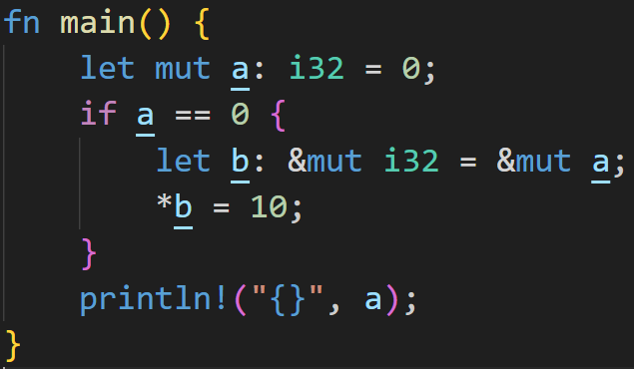
Intermission: Exercise
Time for exercises!
2/3
©Philippe Felix Haupt 2023

Slide 136
Intermission: Exercise
Time for exercises!
Does the code compile? If yes, what does it print?
2/3
©Philippe Felix Haupt 2023

Slide 137
Intermission: Exercise
Time for exercises!
2/3
It compiles, and prints 10
©Philippe Felix Haupt 2023

Slide 138
Intermission: Exercise
Time for exercises!
2/3
* dereferences b, so we’re writing to the original memory location (a)
It compiles, and prints 10
©Philippe Felix Haupt 2023

Slide 139
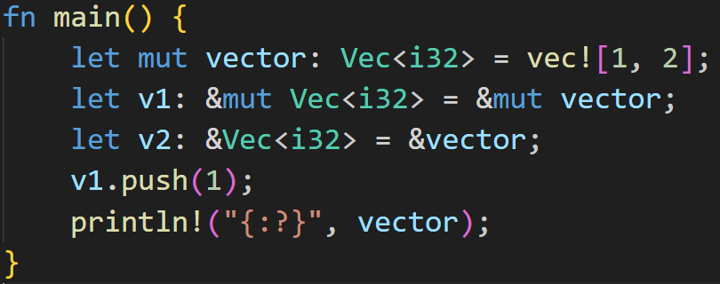
Intermission: Exercise
Time for exercises!
2/3
©Philippe Felix Haupt 2023

Slide 140
Intermission: Exercise
Time for exercises!
2/3
What does the vector look like in the end?
©Philippe Felix Haupt 2023

Slide 141
Intermission: Exercise
Time for exercises!
2/3
Compiler error!
©Philippe Felix Haupt 2023

Slide 142
Intermission: Exercise
Time for exercises!
2/3
Mutable borrow of vector here
Compiler error!
©Philippe Felix Haupt 2023

Slide 143
Intermission: Exercise
Time for exercises!
2/3
Mutable borrow of vector here
Immutable borrow at the same time!
Compiler error!
©Philippe Felix Haupt 2023

Slide 144
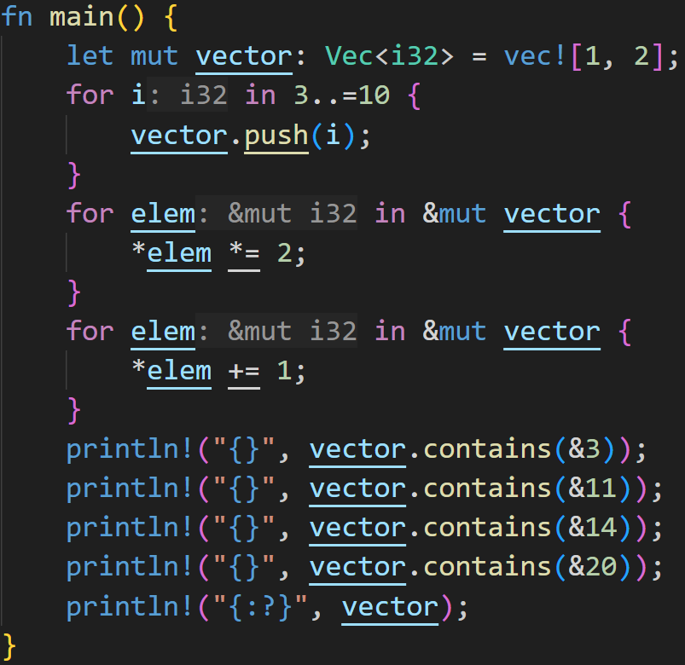
Intermission: Exercise
2/3
©Philippe Felix Haupt 2023

Slide 145
Intermission: Exercise
2/3
Does this compile? If yes, what do we see in the console?
©Philippe Felix Haupt 2023

Slide 146
Intermission: Exercise
2/3
Does this compile? If yes, what do we see in the console?
It does compile!
©Philippe Felix Haupt 2023

Slide 147
Intermission: Exercise
2/3
Does this compile? If yes, what do we see in the console?
It does compile!
We’re finally at a point where we can reuse the same Vector in a for-loop!
©Philippe Felix Haupt 2023

Slide 148
Intermission: Exercise
2/3
Does this compile? If yes, what do we see in the console?
It does compile!
We’re finally at a point where we can reuse the same Vector in a for-loop!
Those for loops modify the elements of the original vector!
©Philippe Felix Haupt 2023

Slide 149
Intermission: Exercise
2/3
Does this compile? If yes, what do we see in the console?
Mutable borrow
Mutable borrow
Mutable borrow
©Philippe Felix Haupt 2023

Slide 150
Intermission: Exercise
2/3
Does this compile? If yes, what do we see in the console?
Mutable borrow
They don’t overlap, so they don’t break borrow checking rules!
Mutable borrow
Mutable borrow
©Philippe Felix Haupt 2023

Slide 151
Intermission: Exercise
2/3
Does this compile? If yes, what do we see in the console?
Mutable borrow
Mutable borrow
Mutable borrow
true
true
false
false
[3, 5, 7, 9, 11, 13, 15, 17, 19, 21]
©Philippe Felix Haupt 2023

Slide 152
Next time
Lifetimes
Functions
©Philippe Felix Haupt 2023

